Slide 1
JKLM Travel Agency
A proposal project of Joeven Valenzuela

Slide 2
Introduction
Summer is up! Now is the best time to enjoy some great vacation spot here in the Philippines. JKLM travel agency helps our valued customer to avail their plane tickets by the touch of their fingertips.

Slide 3
Table description
EMP_TBL
Emp_id [pk]
Emp_fname
Emp_lname
Emp_bonus
Emp_sal
Emp_netsal
TCKT_TBL
Tckt_num [pk]
Cust_id [fk] ]
Emp_id [fk]
Departure
Return
Destination
Origin
CUST_TBL
Cust_id [pk] ]
Cust_fname
Cust_lname
Cust_email [uk]

Slide 4
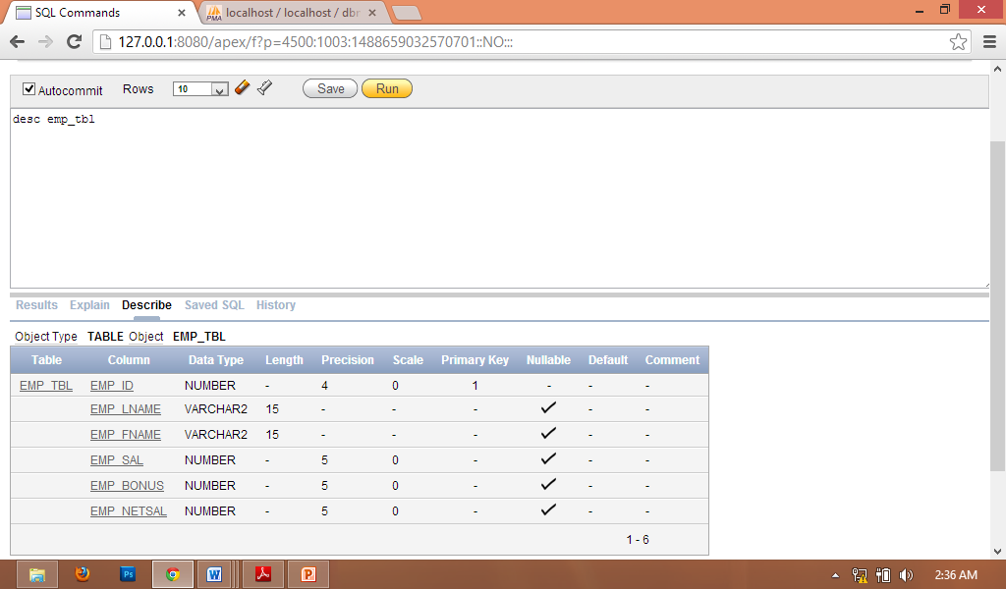
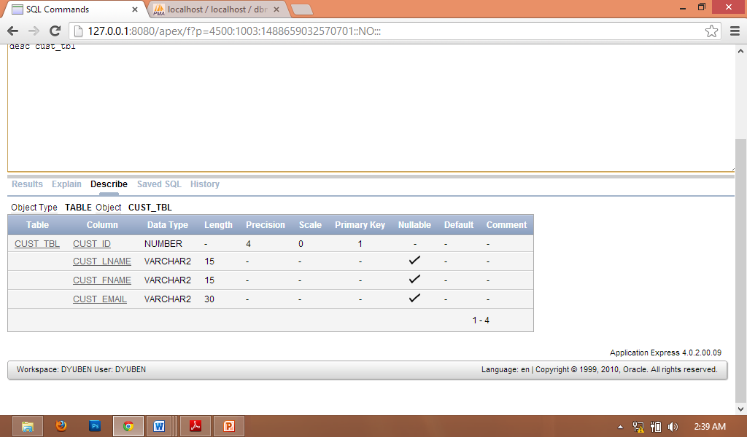
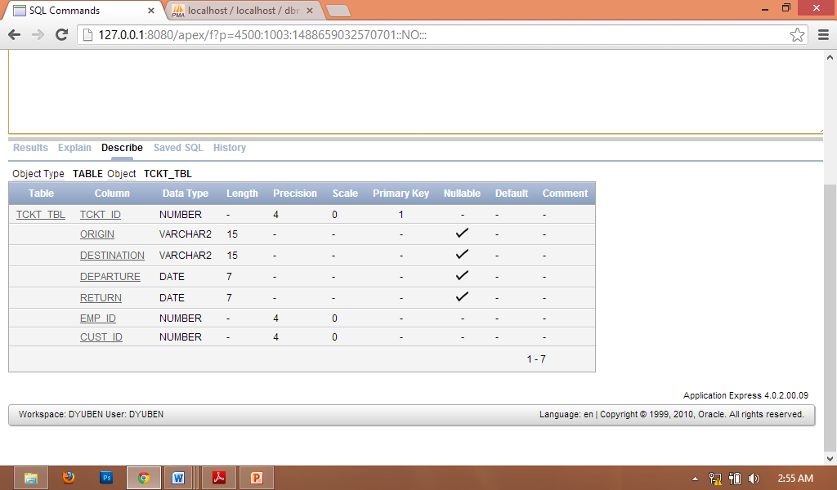

Slide 5
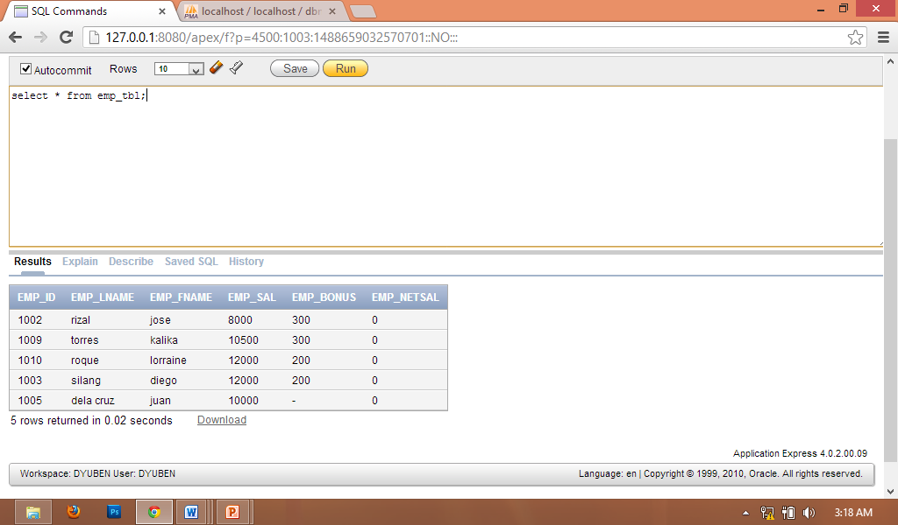
Restriction and Sorting
Select Statement

Slide 6
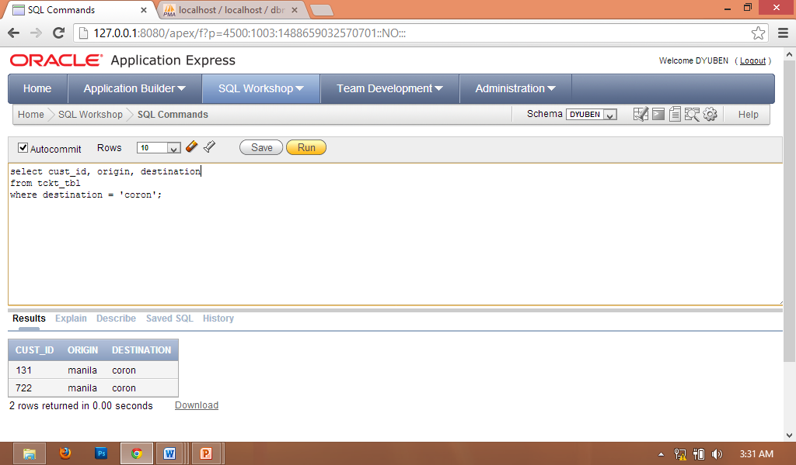
Where Clause

Slide 7
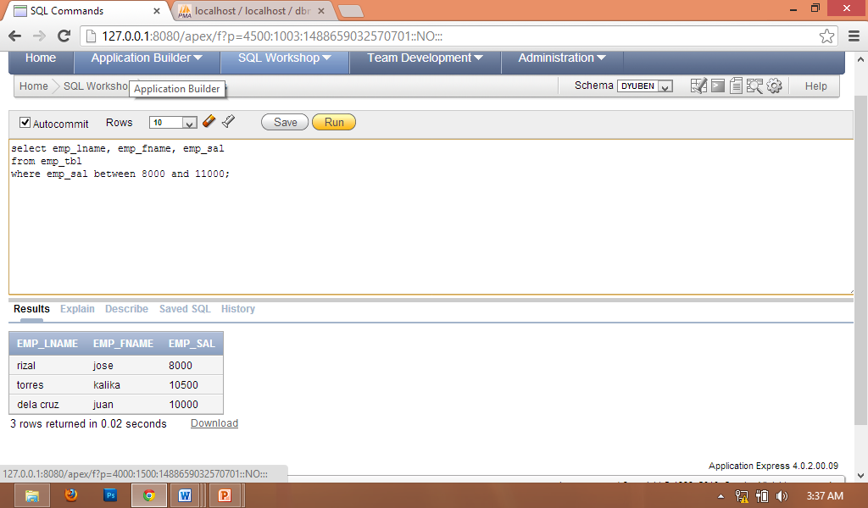
Between Clause

Slide 8
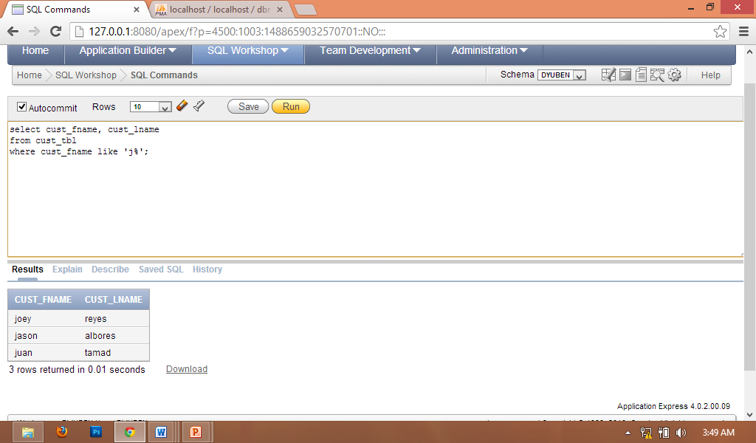
Like Function

Slide 9
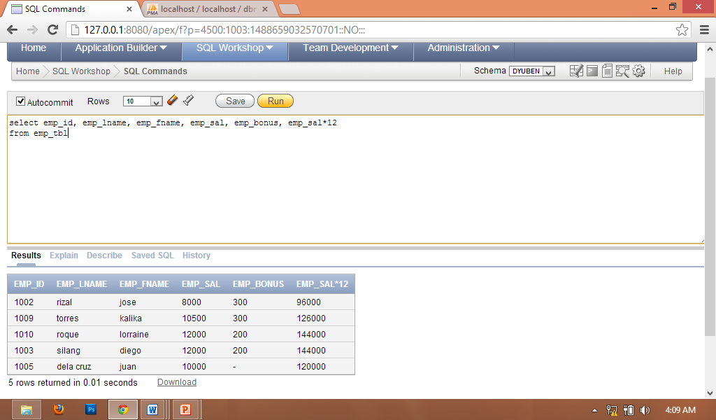
Arithmetic Expressions and Operation

Slide 10
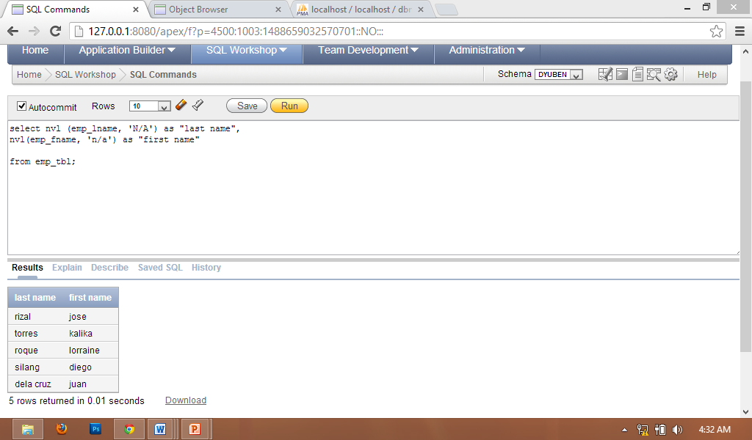
NVL functions

Slide 11
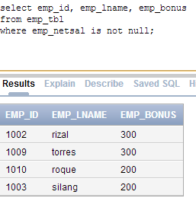
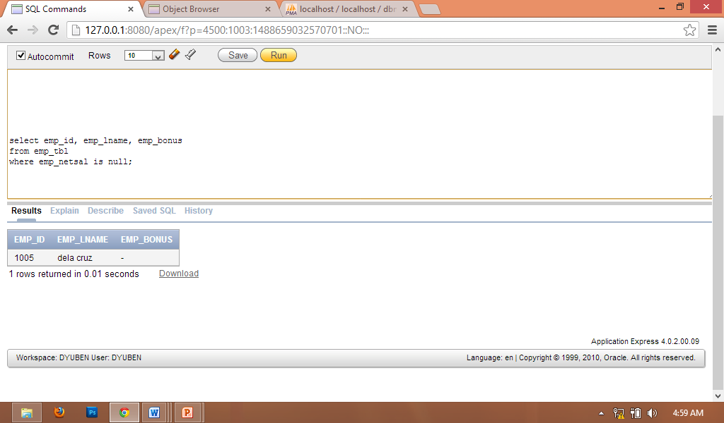
IS NOT NULL/ IS NULL VALUE

Slide 12
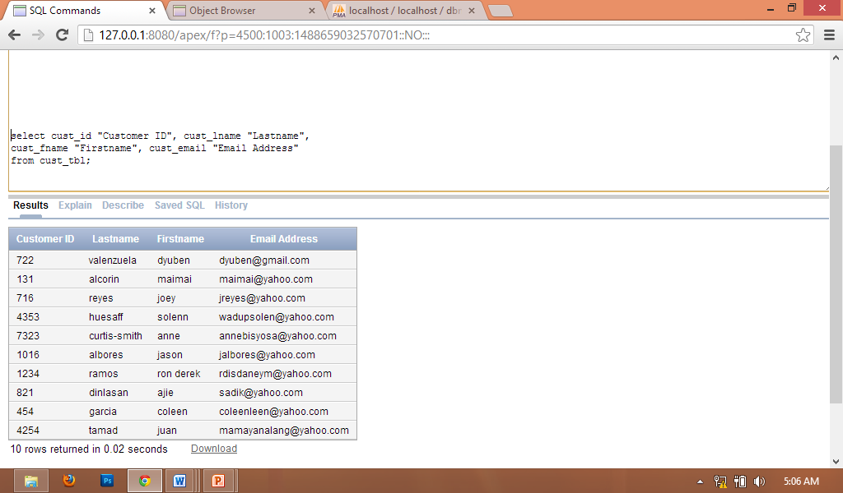
Aliases

Slide 13
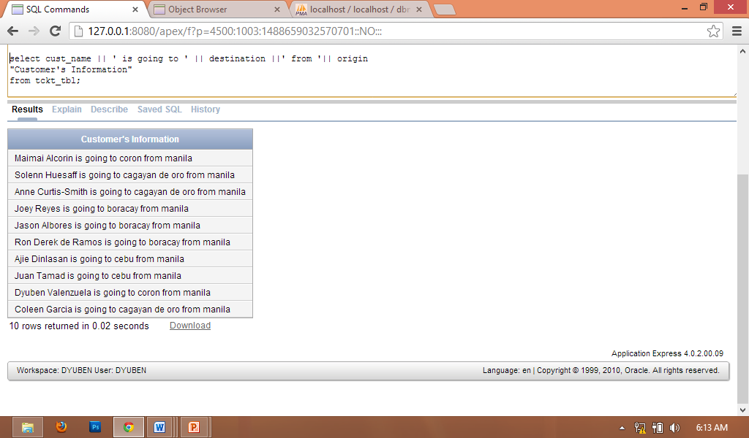
Concatenations

Slide 14
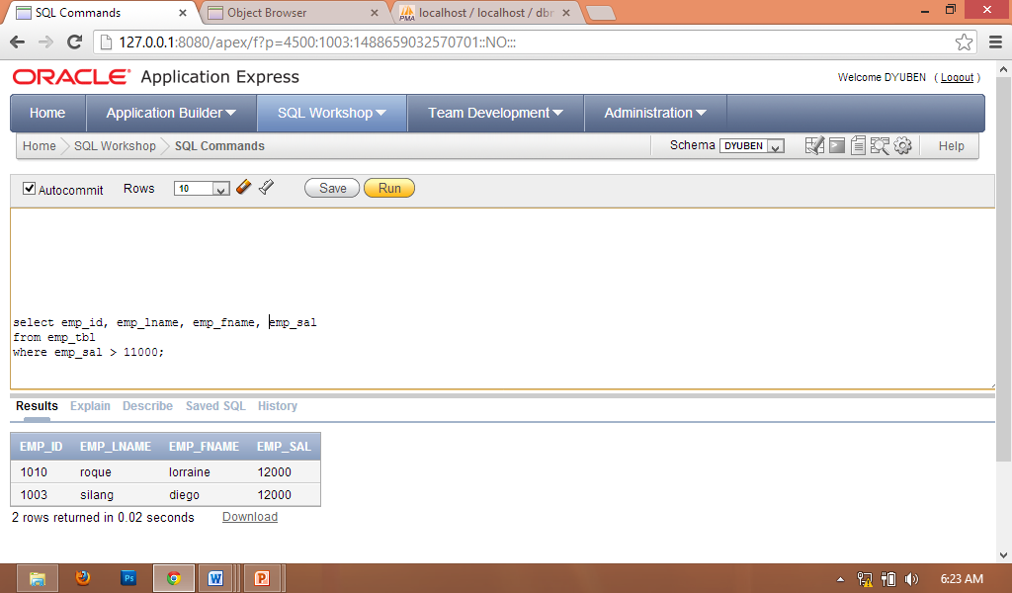
Comparison Operators
OPERATOR | DESCRIPTION
> | Greater than
< | Less than
>= | Greater than or equal
<= | Less than or equal
= | Is equal to
!= | Is not equal to

Slide 15
LOGICAL OPERATOR
OPERATOR | DESCRIPTION
AND | Greater than
OR | Less than
NOT | Greater than or equal

Slide 16
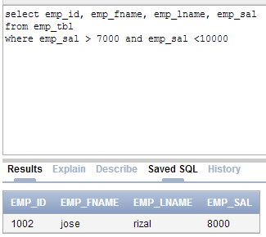
AND

Slide 17
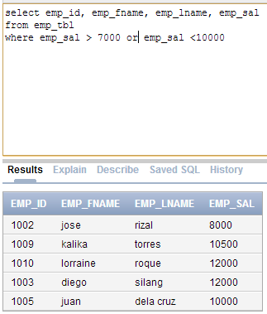
OR

Slide 18
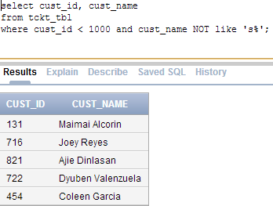
NOT

Slide 19
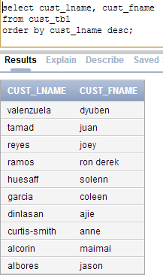
ORDER BY

Slide 20
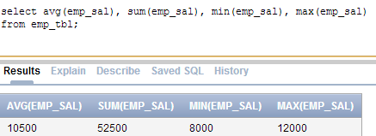
AVG, SUM, MIN, MAX

Slide 21
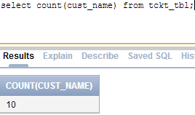
COUNT

Slide 22
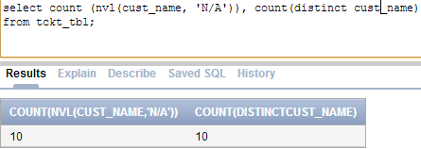
DISTINCT COUNT w/ NVL

Slide 23
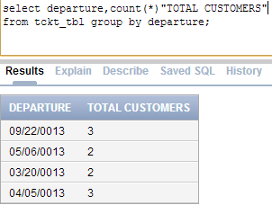
GROUP BY

Slide 24
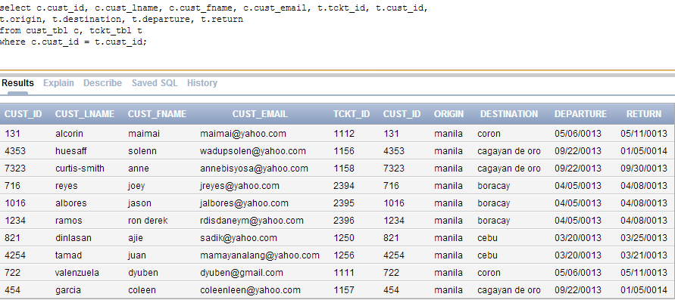
EQUIJOIN

Slide 25
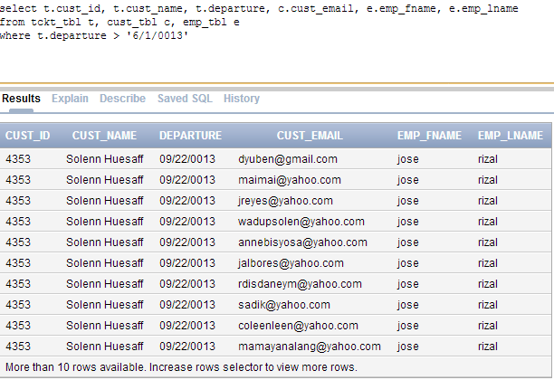
NON EQUIJOIN

Slide 26
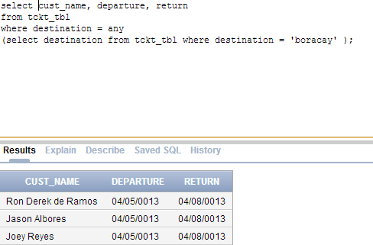
Subqueries

Slide 27
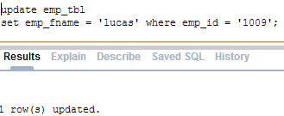
Updating

Slide 28
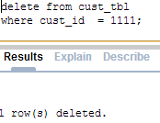
Deleting

Slide 29
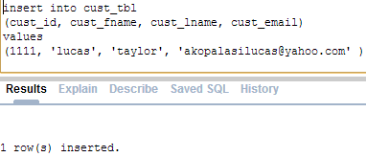
Insert

